Slide 1
Work done and in progress

Slide 2
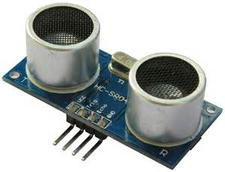
US sensor
HC-SR04

Slide 3
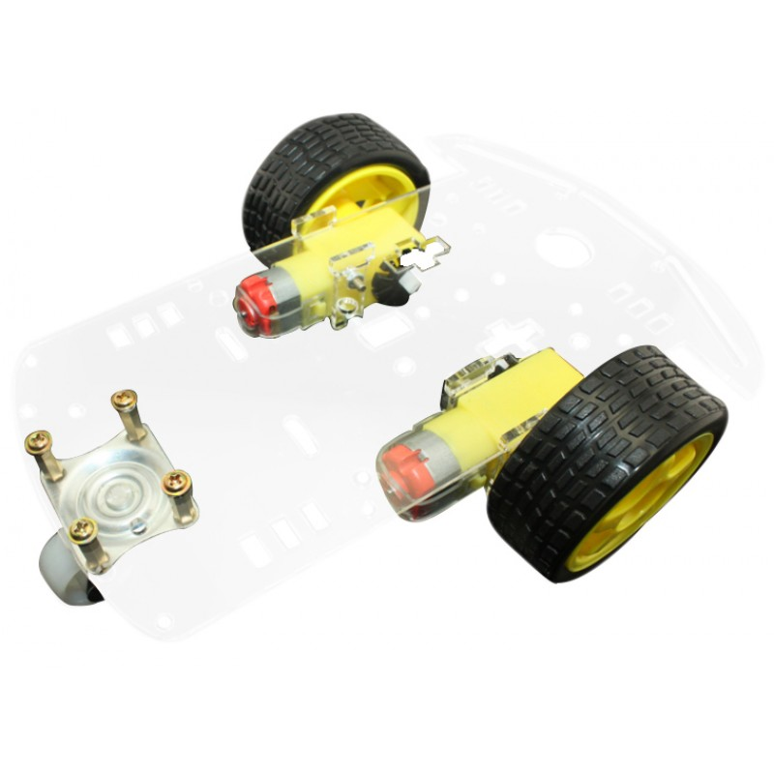
Robot chassie
2WD robot chasis platform with wheel encoder discs
Two gearmotors with 60mm wheels and a rear caster
Acrylic body cut by high-precision lasers
Plastic rims with solid rubber tires

Slide 4
Code
Setup->
Sensor.py->
Process data and make command loop( takes data from set variables to ensure latest )

